Slide 1

INFOSYS 704
IT CONSULTANCY
Labs Content
Lab 7

Slide 2

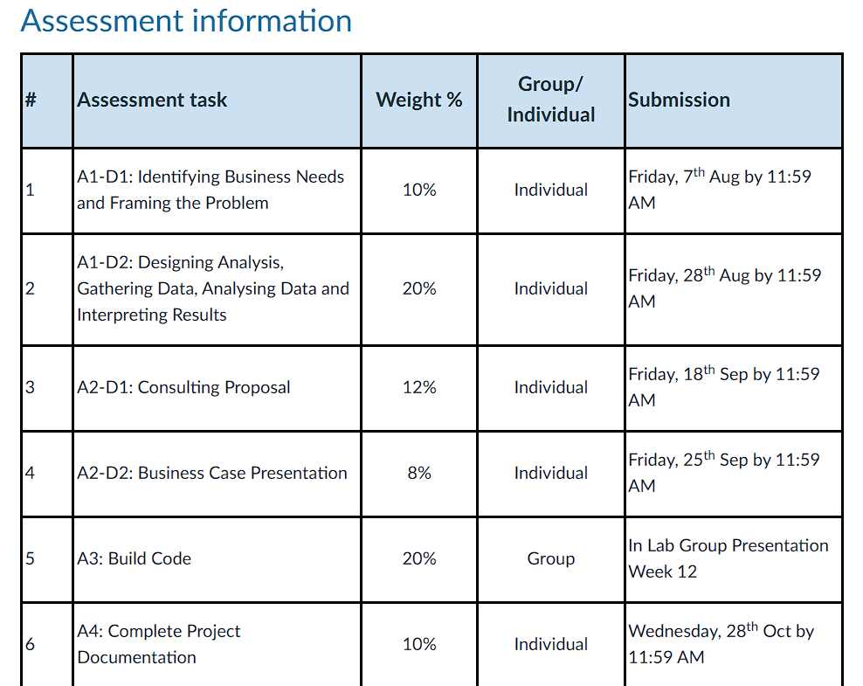

Assignments
Waipapa Taumata Rau, University of Auckland

Slide 3
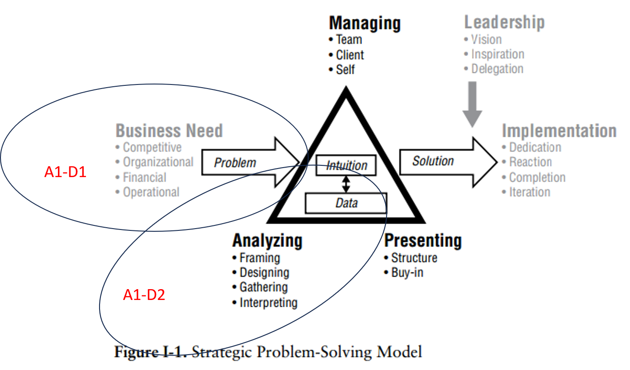
A1| A1-D1: Identifying Business Needs and Framing the Problem |
A1-D2: Designing the Analysis, Gathering the Data, Analysing, and Interpreting Results
  10% + 20% = 30%
  Chapter 1 - 4
Waipapa Taumata Rau, University of Auckland

Slide 4
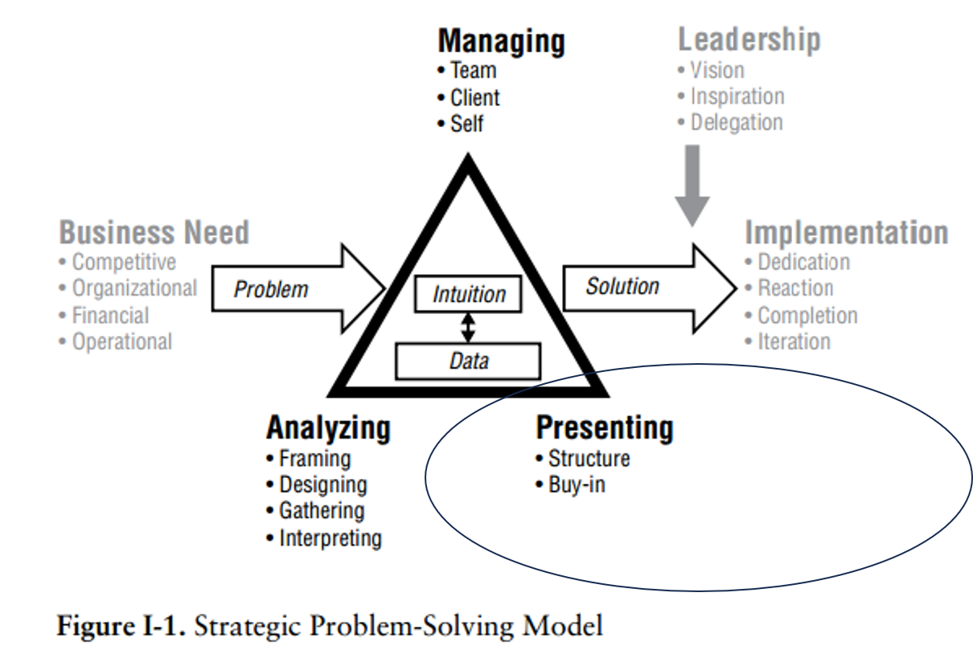
A2 | A2-D1: Consulting Proposal | A2-D2: Presenting Business Case
  12% + 8% = 20%
  Chapter 5 - 8
A2-D1
A2-D2
Waipapa Taumata Rau, University of Auckland

Slide 5
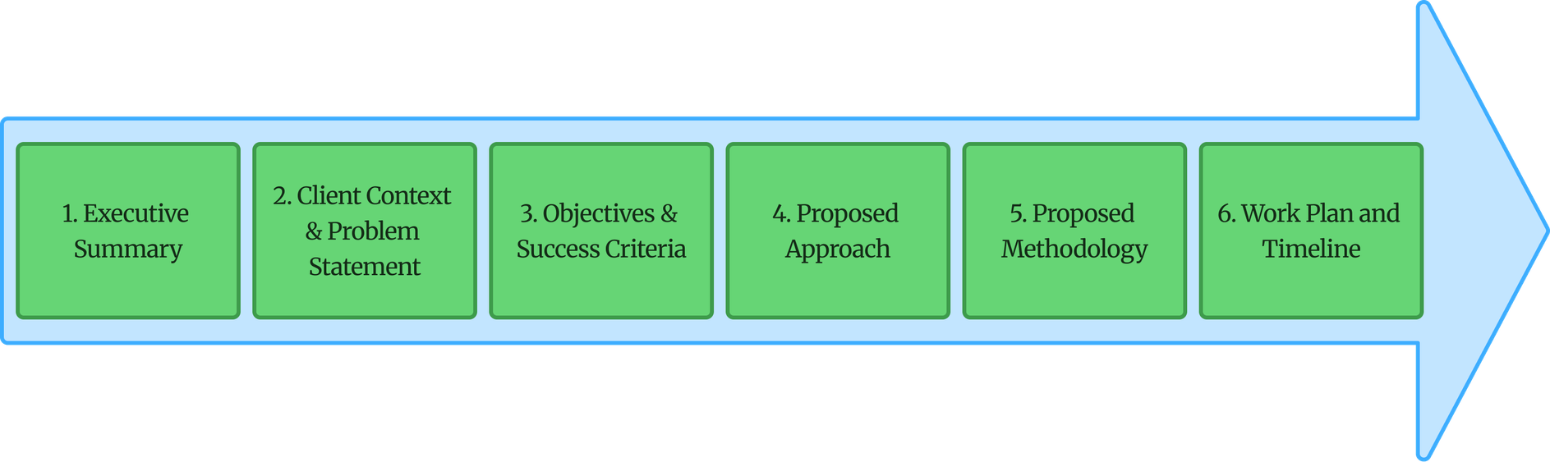
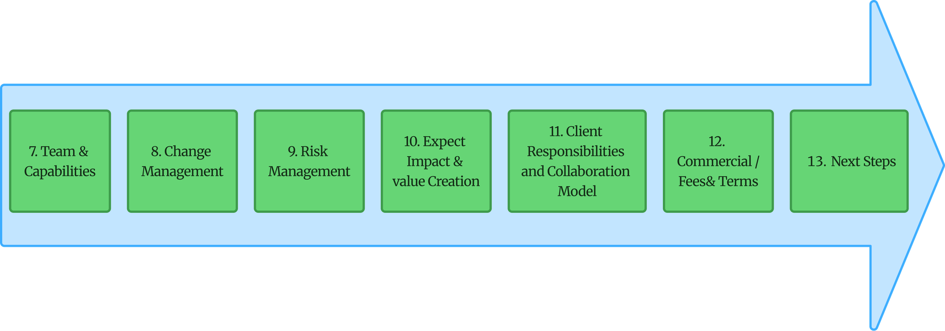
Week 5
Week 6
Waipapa Taumata Rau, University of Auckland

Slide 6
A2-D1: Consulting Proposal
  https://canvas.auckland.ac.nz/courses/121031/assignments/467269
  Refer to Lab Slides Week 5 and 6
Waipapa Taumata Rau, University of Auckland

Slide 7
A2-D2: Business Case Presentation
  https://canvas.auckland.ac.nz/courses/121031/assignments/467270
  Refer to Lab Slides Week 5
Waipapa Taumata Rau, University of Auckland

Slide 8
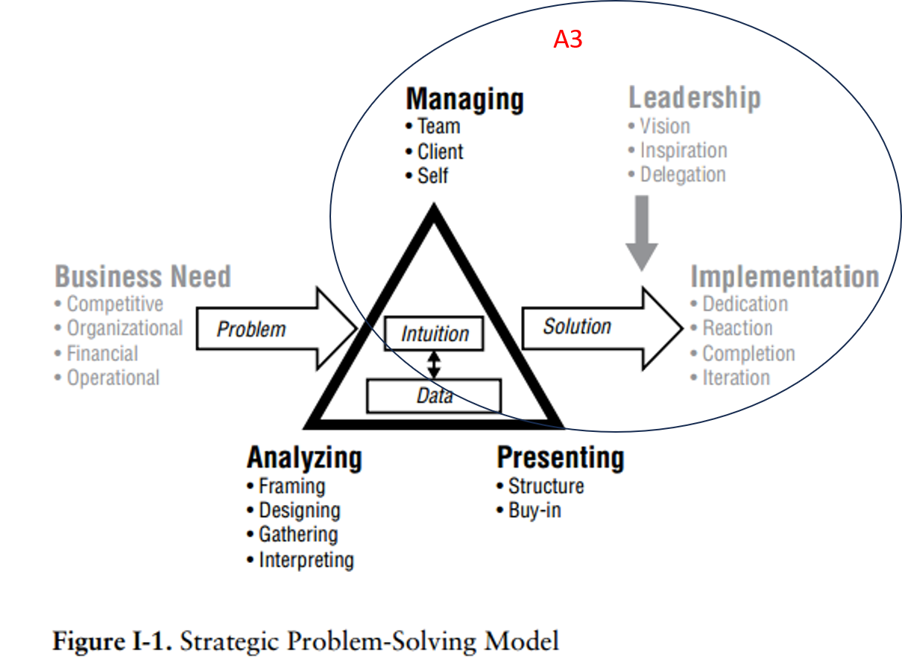
A3: Build App
  20%
Waipapa Taumata Rau, University of Auckland

Slide 9
A3: Build App. - Specifications
  Specification Document
  https://canvas.auckland.ac.nz/courses/121031/assignments/472998
  Groupwork Disclaimer Slide
  https://canvas.auckland.ac.nz/courses/121031/assignments/472998
Waipapa Taumata Rau, University of Auckland

Slide 10
A3: Build App. - Group Assignment
  Sit in Groups Together on Tuesdays in Associated Lab Streams (Link)
  Discuss and Select One Solution to be Implemented
  Week 8 - SAP Introduction and SAP build Environment (AppGyver)
  Week 9 - Design Thinking and Build App.
  Week 10 - Build App
  Week 11 - SAP Walkaround to help complete Build App. and Introduction to A4: Overall Project Document
  Week 12 - Presentations (5 Minutes)
Waipapa Taumata Rau, University of Auckland

Slide 11
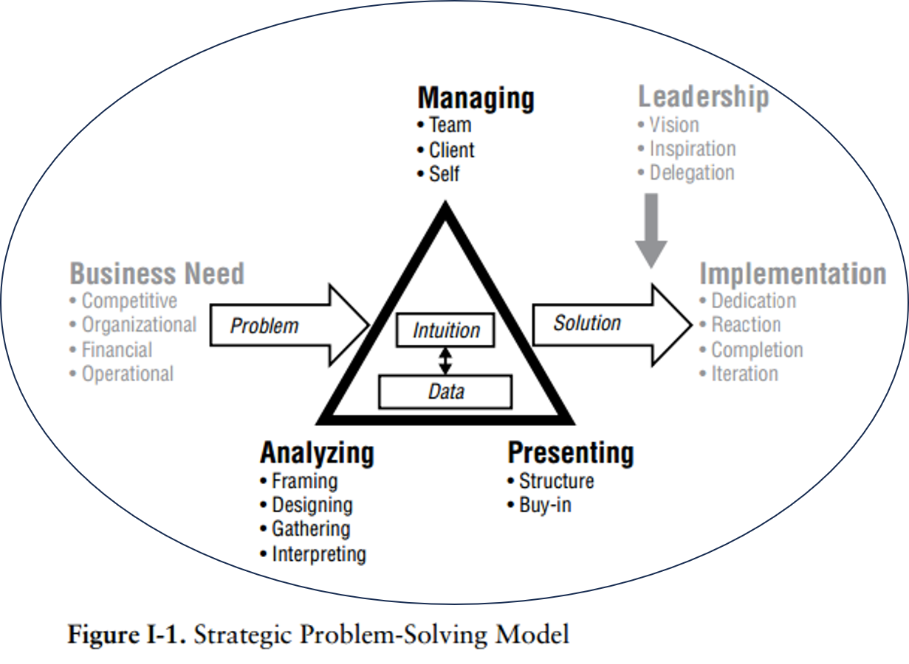
A4: Complete Project Documentation - Individual
A4
  10%
Waipapa Taumata Rau, University of Auckland

Slide 12
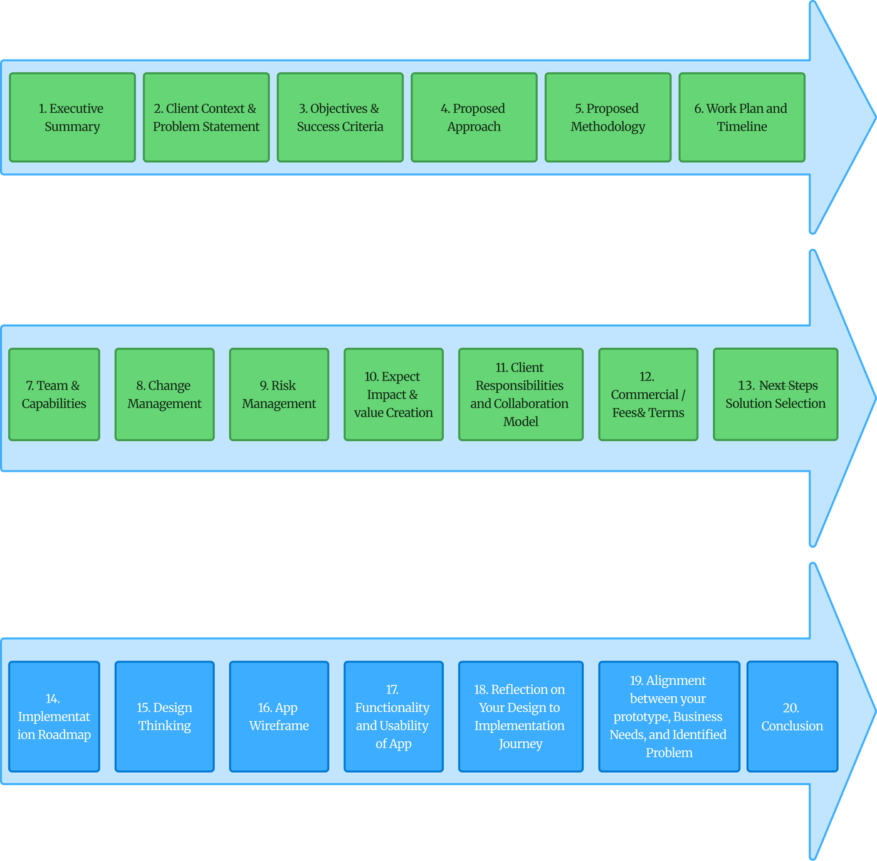
Complete Project Documentation: Plan Draft
Waipapa Taumata Rau, University of Auckland

Slide 13
2 X 2 Matrix for Solution Selection / Prioritisation
  YouTube
    https://www.youtube.com/watch?v=ODr-xd8LsDI
  ASQ
    Impact Effort Matrix
  GAI
    Gemini
Waipapa Taumata Rau, University of Auckland

Slide 14
NEXT LAB (WK 6) (LAB 6)
  Continue working on A2
Waipapa Taumata Rau, University of Auckland

Slide 15

Thanks Guys :)
Waipapa Taumata Rau, University of Auckland

